Slide 1


Project Report
COVID-Extractor
Student: Jerry Gou(jg6226), Chen Chen(cc6475),Guokun Liu(gl1870)
Advisor: Juliana Freire
5/03/2018

Slide 2
Problem
Problem:
1. How does COVID-19 affect the volatility of each industry?
2. Which industries are more stable and which are not during the epidemic?
Notes:
Now with the event-based social networks, we focus on the group pop pred prob, the reason we find it interesting is that … we hope it can give us some insight of how to grow our community in real life.
Specifically, we ask two questions: first, … to measure the success of a group we use rsvp num, a rsvp is generated whenever a user accept an event invitation. We only focus on new groups because the pred for new is more challenging because very few
Second, what are the factors that best predict a group’s success? To some extent, this is equivalent to find the best features.

Slide 3
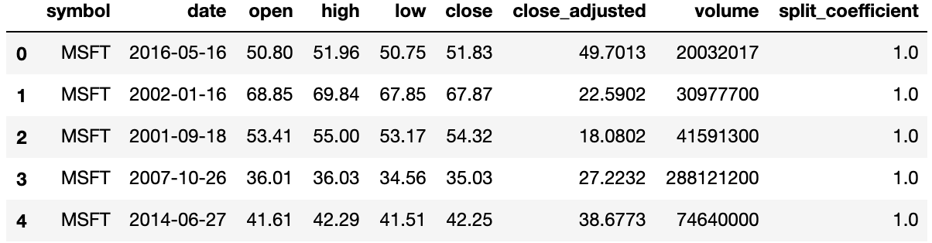
Dataset
Datasets:
1. Stock price dataset
Format: (symbol, open price, , high, ……,close price , …… , Attribute N)
Content: daily price of each stock
Notes:
Actually for this problem, that is the group popularity prediction problem, researchers have already done some excellent works, for example in these two works,
4 types of features are used to predict the group’s popularity. They are …
And then they input the features into classical ML methods to make the predictions.

Slide 4
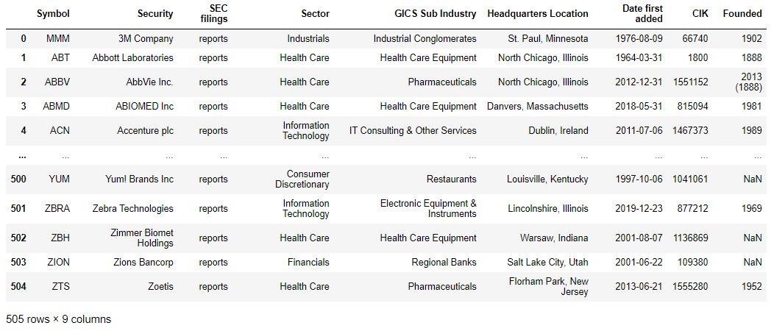
Dataset
2. Stock Sector information dataset
Format: (stock ticker, Attribute 1, , Attribute 2, ……,GICS sector , …… , Attribute N)
Content: Information on each stock in the S & P 500 (including Global Industry Classification Standard Sector information)
Notes:
Actually for this problem, that is the group popularity prediction problem, researchers have already done some excellent works, for example in these two works,
4 types of features are used to predict the group’s popularity. They are …
And then they input the features into classical ML methods to make the predictions.

Slide 5
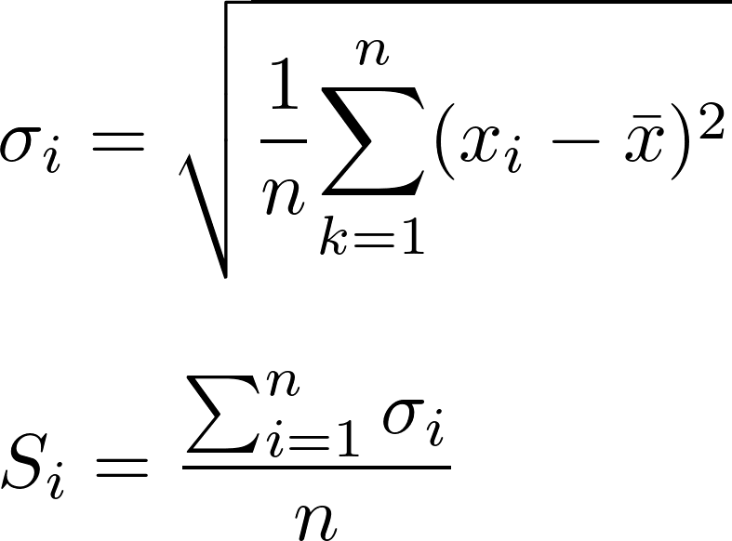
Problem
Methodology
1. Use the standard deviation of the stock prices of various companies during the epidemic to estimate the degree of instability of each industry.
Greater standard deviation means higher volatility.
Notes:
Now with the event-based social networks, we focus on the group pop pred prob, the reason we find it interesting is that … we hope it can give us some insight of how to grow our community in real life.
Specifically, we ask two questions: first, … to measure the success of a group we use rsvp num, a rsvp is generated whenever a user accept an event invitation. We only focus on new groups because the pred for new is more challenging because very few
Second, what are the factors that best predict a group’s success? To some extent, this is equivalent to find the best features.

Slide 6
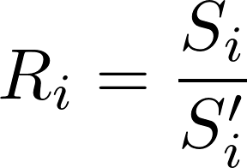


Problem
Methodology
2. Compare the degree of instability of each industry with that of the same period last year to find which industries are more affected by COVID-19.
is the degree of instability of industry i during the epidemic and is the degree of instability of industry i during the same time of last year.
Notes:
Now with the event-based social networks, we focus on the group pop pred prob, the reason we find it interesting is that … we hope it can give us some insight of how to grow our community in real life.
Specifically, we ask two questions: first, … to measure the success of a group we use rsvp num, a rsvp is generated whenever a user accept an event invitation. We only focus on new groups because the pred for new is more challenging because very few
Second, what are the factors that best predict a group’s success? To some extent, this is equivalent to find the best features.

Slide 7
Problem
Challenge:
The price of the stock is influenced by too many factors, and it is almost impossible to predict the price of the stock. Moreover, it is difficult to find the relationship between the stock price and the number of cases of COVID-19.
In this case, I changed my perspective and started to analyze the impact of the epidemic on the stock market by observing the volatility of each industry.
Notes:
Now with the event-based social networks, we focus on the group pop pred prob, the reason we find it interesting is that … we hope it can give us some insight of how to grow our community in real life.
Specifically, we ask two questions: first, … to measure the success of a group we use rsvp num, a rsvp is generated whenever a user accept an event invitation. We only focus on new groups because the pred for new is more challenging because very few
Second, what are the factors that best predict a group’s success? To some extent, this is equivalent to find the best features.

Slide 8
Problem
Result:
If we focus on the standard deviation of each industry, Consumer Staples and Utilities related companies are the most stable during the outbreak of COVID-19 and Consumer Discretionary related companies show extreme instability.
Notes:
Now with the event-based social networks, we focus on the group pop pred prob, the reason we find it interesting is that … we hope it can give us some insight of how to grow our community in real life.
Specifically, we ask two questions: first, … to measure the success of a group we use rsvp num, a rsvp is generated whenever a user accept an event invitation. We only focus on new groups because the pred for new is more challenging because very few
Second, what are the factors that best predict a group’s success? To some extent, this is equivalent to find the best features.

Slide 9
Problem
Result:
Compared with last year's data, all industries have been affected and show greater volatility during the epidemic, especially the energy industry and the financial industry which have shown greater instability.
Notes:
Now with the event-based social networks, we focus on the group pop pred prob, the reason we find it interesting is that … we hope it can give us some insight of how to grow our community in real life.
Specifically, we ask two questions: first, … to measure the success of a group we use rsvp num, a rsvp is generated whenever a user accept an event invitation. We only focus on new groups because the pred for new is more challenging because very few
Second, what are the factors that best predict a group’s success? To some extent, this is equivalent to find the best features.

Slide 10
Problem
Result(Sub-industry)
Although the standard deviation of the stock price of the publishing industry is not large and it is one of the most stable industries, its degree of instability has increased more than 8 times compared with last year.
Notes:
Now with the event-based social networks, we focus on the group pop pred prob, the reason we find it interesting is that … we hope it can give us some insight of how to grow our community in real life.
Specifically, we ask two questions: first, … to measure the success of a group we use rsvp num, a rsvp is generated whenever a user accept an event invitation. We only focus on new groups because the pred for new is more challenging because very few
Second, what are the factors that best predict a group’s success? To some extent, this is equivalent to find the best features.

Slide 11
Problem
Limitation:
The degree of volatility can only represent whether the stock price is stable, it can't directly reflect whether the epidemic's impact on these industries is positive or negative. For example, Internet & Direct Marketing Retail is one the most affected sub-industry, but the trend of stock price changes of two companies in this sub-industry is completely opposite. Amazon reached its highest stock price now while Expedia's stock price is now only half that before the outbreak before the COVID-19.
Thus, we need more methods to analyze the impact of the epidemic on certain industries or specific companies which is exactly what my teammates are doing.
Notes:
Now with the event-based social networks, we focus on the group pop pred prob, the reason we find it interesting is that … we hope it can give us some insight of how to grow our community in real life.
Specifically, we ask two questions: first, … to measure the success of a group we use rsvp num, a rsvp is generated whenever a user accept an event invitation. We only focus on new groups because the pred for new is more challenging because very few
Second, what are the factors that best predict a group’s success? To some extent, this is equivalent to find the best features.

Slide 12
Problem
Thanks!
Notes:
Now with the event-based social networks, we focus on the group pop pred prob, the reason we find it interesting is that … we hope it can give us some insight of how to grow our community in real life.
Specifically, we ask two questions: first, … to measure the success of a group we use rsvp num, a rsvp is generated whenever a user accept an event invitation. We only focus on new groups because the pred for new is more challenging because very few
Second, what are the factors that best predict a group’s success? To some extent, this is equivalent to find the best features.

